Slide 1
Chapter 3
Agile Development
Slide Set to accompany Software Engineering: A Practitioner’s Approach, 7/e
by Roger S. Pressman
Slides copyright © 1996, 2001, 2005, 2009 by Roger S. Pressman
For non-profit educational use only
May be reproduced ONLY for student use at the university level when used in conjunction with Software Engineering: A Practitioner's Approach, 7/e. Any other reproduction or use is prohibited without the express written permission of the author.
All copyright information MUST appear if these slides are posted on a website for student use.

Slide 2
The Manifesto for Agile Software Development
“We are uncovering better ways of developing software by doing it and helping others do it. Through this work we have come to value:
Individuals and interactions over processes and tools
Working software over comprehensive documentation
Customer collaboration over contract negotiation
Responding to change over following a plan
That is, while there is value in the items on the right, we value the items on the left more.”
Kent Beck et al

Slide 3
What is “Agility”?
Effective (rapid and adaptive) response to change
Effective communication among all stakeholders
Drawing the customer onto the team
Organizing a team so that it is in control of the work performed
Yielding …
Rapid, incremental delivery of software

Slide 4
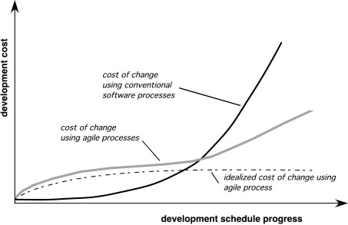
Agility and the Cost of Change

Slide 5
An Agile Process
Is driven by customer descriptions of what is required (scenarios)
Recognizes that plans are short-lived
Develops software iteratively with a heavy emphasis on construction activities
Delivers multiple ‘software increments’
Adapts as changes occur

Slide 6
Agility Principles - I
1. Our highest priority is to satisfy the customer through early and continuous delivery of valuable software.
2. Welcome changing requirements, even late in development. Agile processes harness change for the customer's competitive advantage.
3. Deliver working software frequently, from a couple of weeks to a couple of months, with a preference to the shorter timescale.
4. Business people and developers must work together daily throughout the project.
5. Build projects around motivated individuals. Give them the environment and support they need, and trust them to get the job done.
6. The most efficient and effective method of conveying information to and within a development team is face–to–face conversation.

Slide 7
Agility Principles - II
7. Working software is the primary measure of progress.
8. Agile processes promote sustainable development. The sponsors, developers, and users should be able to maintain a constant pace indefinitely.
9. Continuous attention to technical excellence and good design enhances agility.
10. Simplicity – the art of maximizing the amount of work not done – is essential.
11. The best architectures, requirements, and designs emerge from self–organizing teams.
12. At regular intervals, the team reflects on how to become more effective, then tunes and adjusts its behavior accordingly.

Slide 8
Human Factors
the process molds to the needs of the people and team, not the other way around
key traits must exist among the people on an agile team and the team itself:
Competence.
Common focus.
Collaboration.
Decision-making ability.
Fuzzy problem-solving ability.
Mutual trust and respect.
Self-organization.

Slide 9
Extreme Programming (XP)
The most widely used agile process, originally proposed by Kent Beck
XP Planning
Begins with the creation of “user stories”
Agile team assesses each story and assigns a cost
Stories are grouped to for a deliverable increment
A commitment is made on delivery date
After the first increment “project velocity” is used to help define subsequent delivery dates for other increments

Slide 10
Extreme Programming (XP)
XP Design
Follows the KIS principle
Encourage the use of CRC cards (see Chapter 8)
For difficult design problems, suggests the creation of “spike solutions”—a design prototype
Encourages “refactoring”—an iterative refinement of the internal program design
XP Coding
Recommends the construction of a unit test for a store before coding commences
Encourages “pair programming”
XP Testing
All unit tests are executed daily
“Acceptance tests” are defined by the customer and excuted to assess customer visible functionality

Slide 11
Extreme Programming (XP)

Slide 12
Industrial XP
Joshua Kerievsky describes Industrial Extreme Programming (IXP) in the following manner: “IXP is an organic evolution of XP. It is imbued with XP’s minimalist, customer-centric, test-driven spirit. IXP differs most from the original XP in its greater inclusion of management, its expanded role for customers, and its upgraded technical practices.”
IXP incorporates six new practices that are designed to help ensure that an XP project works successfully for significant projects within a large organization.

Slide 13
Contd…
Readiness assessment. Prior to the initiation of an IXP project, the organization should conduct a readiness assessment. The assessment ascertains whether:
an appropriate development environment exists to support IXP,
the team will be populated by the proper set of stakeholders,
the organization has a distinct quality program and supports continuous improvement,
the organizational culture will support the new values of an agile team, and
the broader project community will be populated appropriately.

Slide 14
Contd…
Project community. Classic XP suggests that the right people be used to populate the agile team to ensure success. The implication is that people on the team must be well-trained, adaptable and skilled, and have the proper temperament to contribute to a self-organizing team. When XP is to be applied for a significant project in a large organization, the concept of the “team” should morph into that of a community. A community may have a technologist and customers who are central to the success of a project as well as many other stakeholders (e.g., legal staff, quality auditors, manufacturing or sales types)

Slide 15
Contd…
Project chartering. The IXP team assesses the project itself to determine whether an appropriate business justification for the project exists and whether the project will further the overall goals and objectives of the organization.
Chartering also examines the context of the project to determine how it complements, extends, or replaces existing systems or processes.

Slide 16
Contd…
Test-driven management. An IXP project requires measurable criteria for assessing the state of the project and the progress that has been made to date.
Test-driven management establishes a series of measurable “destinations” and then defines mechanisms for determining whether or not these destinations have been reached.
Retrospectives. An IXP team conducts a specialized technical review after a software increment is delivered. Called a retrospective, the review examines “issues, events, and lessons-learned” across a software increment and/or the entire software release.
The intent is to improve the IXP process.

Slide 17
Contd…
Continuous learning. Because learning is a vital part of continuous process improvement, members of the XP team are encouraged (and possibly, incented) to learn new methods and techniques that can lead to a higher quality product.

Slide 18
XP Debate
Requirements volatility
Conflicting customer needs
Requirements are expressed informally
Lack of formal design

Slide 19
Other agile process models
Other agile process models have been proposed and are in use across the industry. Among the most common are:
Dynamic Systems Development Method (DSDM)
Scrum
Agile Modeling (AM)
Agile Unified Process (AUP)

Slide 20
Dynamic Systems Development Method
Promoted by the DSDM Consortium (www.dsdm.org)
DSDM—distinguishing features
Similar in most respects to XP and/or ASD
Nine guiding principles
Active user involvement is imperative.
DSDM teams must be empowered to make decisions.
The focus is on frequent delivery of products.
Fitness for business purpose is the essential criterion for acceptance of deliverables.
Iterative and incremental development is necessary to converge on an accurate business solution.
All changes during development are reversible.
Requirements are baselined at a high level
Testing is integrated throughout the life-cycle.

Slide 21
Contd…
The DSDM life cycle that defines three different iterative cycles, preceded by two additional life cycle activities:
Feasibility study—establishes the basic business requirements and constraints associated with the application to be built and then assesses whether the application is a viable candidate for the DSDM process
Business study—establishes the functional and information requirements that will allow the application to provide business value; also, defines the basic application architecture and identifies the maintainability requirements for the application.
Functional model iteration—produces a set of incremental prototypes that demonstrate functionality for the customer.

Slide 22
Contd…
Design and build iteration—revisits prototypes built during functional model iteration to ensure that each has been engineered in a manner that will enable it to provide operational business value for end users. In some cases, functional model iteration and design and build iteration occur concurrently.
Implementation—places the latest software increment into the operational environment. It should be noted that (1) the increment may not be 100 percent complete or (2) changes may be requested as the increment is put into place.
In either case, DSDM development work continues by returning to the functional model iteration activity.

Slide 23
Scrum
Originally proposed by Schwaber and Beedle
Scrum—distinguishing features
Development work is partitioned into “packets”
Testing and documentation are on-going as the product is constructed
Work occurs in “sprints” and is derived from a “backlog” of existing requirements
Meetings are very short and sometimes conducted without chairs
“demos” are delivered to the customer with the time-box allocated

Slide 24
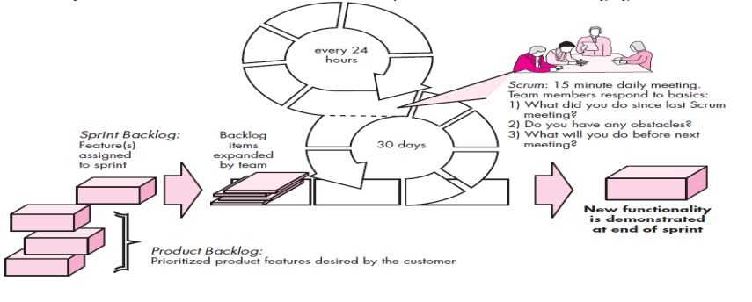
Scrum

Slide 25
Agile Modeling
Originally proposed by Scott Ambler
Suggests a set of agile modeling principles
Model with a purpose
Use multiple models
Travel light
Content is more important than representation
Know the models and the tools you use to create them
Adapt locally

Slide 26
Agile Unified Process (AUP)
The Agile Unified Process (AUP) adopts a “serial in the large” and “iterative in the small” philosophy for building computer-based systems.
By adopting the classic UP phased activities—inception, elaboration, construction, and transition—AUP provides a serial overlay that enables a team to visualize the overall process flow for a software project.
However, within each of the activities, the team iterates to achieve agility and to deliver meaningful software increments to end users as rapidly as possible. Each AUP iteration addresses the following activities.

Slide 27
Contd…
Modeling. UML representations of the business and problem domains are created.
Implementation. Models are translated into source code.
Testing. Like XP, the team designs and executes a series of tests to uncover errors and ensure that the source code meets its requirements.
Deployment. Like the generic process activity deployment in this context focuses on the delivery of a software increment and the acquisition of feedback from end users.
Configuration and project management. In the context of AUP, configuration management addresses change management, risk management, and the control of any persistent work products that are produced by the team.
Project management tracks and controls the progress of the team and coordinates team activities.
Environment management. Environment management coordinates a process infrastructure that includes standards, tools, and other support technology available to the team.

Slide 28
When to use the Agile Model?
When frequent changes are required.
When a highly qualified and experienced team is available.
When a customer is ready to have a meeting with a software team all the time.
When project size is small.

Slide 29
Advantages of Agile model
Frequent Delivery
Face-to-Face Communication with clients.
Efficient design and fulfils the business requirement.
Anytime changes are acceptable.
It reduces total development time.

Slide 30
Disadvantages
Due to the shortage of formal documents, it creates confusion and crucial decisions taken throughout various phases can be misinterpreted at any time by different team members.
Due to the lack of proper documentation, once the project completes and the developers allotted to another project, maintenance of the finished project can become a difficulty.

